Slide 1

NON INVASIVE HEARING AID USING THE NATURAL AMPLIFICATION OF EAR THROUGH BONE CONDUCTION
SUBMITTED BY : GUIDED BY :
V SUNDARAM (RA1511004020006) Mrs P.Thersa , M.E
P V SWAMYNATHAN (RA1511004020044) Assistant Professor
A KISHORE KUMAR (RA1511004020045)
AJITH CHANDRAN K (RA1511004020051)
NISANTH M B (RA1511004020057)

Slide 2
ABSTRACT
Several hearing aids have been invented for outer ear drum problems whereas inner ear drum problem is permanent and it can be fixed only by surgical means. This hearing aid is designed to use the natural amplification of ear . Any signal that is received by the GSM module is transmitted to the piezoelectric actuator by the PIC controller which generates the vibrations that is sent to cochlea through the teeth .This way the sound is imported from the impaired ear to hearing ear. This device can be fixed on the teeth and no alteration of the teeth is required and it is non invasive.

Slide 3
LITERATURE SURVEY
1.Yash Gupta & Praveen Kumar, Amity University “Bone Conduction Auxiliary and Tactics for Man machine Interface for Hearing Impaired Users” ICACCE 2018
The paper addresses the inner ear drum hearing losses which does not rectify the hearing loss but amplifies the sound or making it louder so that it reaches the inner ear .
2. Liu CC, David Livingstone, Warren Yunker. “The role of bone conduction hearing aid in congenital hearing loss: A review.” Journal of Pediatric Otorhinolaryngology,1Jan 5, 2017.
The paper presents the bone conduction devices that enables people with impaired hearing to gain the ability to hear without the usage of their ear drums. They also specified different bone conduction devices based on different principles.

Slide 4
EXISTING SYSTEM
Several hearing devices were found for outer drum problem only.
Inner drum problem is usually a permanent condition which impairs one’s ability to tell the direction a sound is coming from.
It can also be responsible for difficulty in understanding speech or conversations on the deaf ear side, particularly in a noisy environment.
Some medical treatments has been proposed but it requires surgery. Due to the surgery it might lead to additional problems.

Slide 5
OBJECTIVE
The objective of this presented work is to aid the hearing impaired users to receive incoming calls and hear music without any surgical implantations. This process is based upon the BONE CONDUCTION PRINCIPLE (in the mouth).

Slide 6
PROPOSED SYSTEM
This hearing device is designed to use the natural amplification of your ear. Any sound that is coming from GSM Modem , it uses a digital processor (PIC16F877A) to transmit to the sound to a piezoelectric actuator which needs very little power to generate the vibrations that travel through bone, which in turn sends those sound vibrations into your cochlea through your teeth. This way, the sound is transported from your impaired ear directly to your hearing ear.

Slide 7
BONE CONDUCTION
Bone conduction is the conduction of sound to the inner ear through the bones of the skull. Bone conduction transmission can be used with individuals with impaired hearings.
Bone conduction devices are used to transfer the sound vibration through the bones rather than air conduction through ear drums.
Based upon the principle of conduction these devices are classified into (1) Skin Drive BCD’s (2) Direct Drive BCD’s (3) In-Mouth BCD’s.

Slide 8
In-Mouth BCD’s
Sound is transmitted via teeth to the skull bone, these sound vibrations are created by a piezoelectric transducer. These vibrations are transmitted to the upper back teeth and then transmitted to the inner ear (cochlea) via the skull bone .

Slide 9
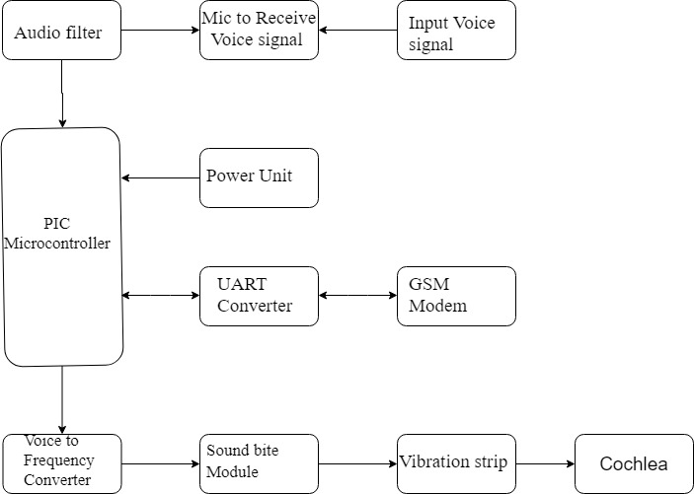
BLOCK DIAGRAM

Slide 10
REQUIREMENTS
HARDWARE:
PIC Microcontroller(PIC16F877A)
GSM Modem (SIM800A)
Playback Module
Relay system
UART Module
Audio Amplifier
SOFTWARE:
MP LAB IDE

Slide 11
ADVANTAGES
Non-invasive
Alteration of the teeth is not required
Easily removable
Portable
Customizable
DISADVANTAGES
Wired Module
Device is quite big
Face to Face interaction is not possible

Slide 12
APPLICATIONS
This hearing device is a flat piece and real time product which can be used in day to day life by the hearing impaired users to receive incoming calls and hear music without any surgical implantations. It does not have any duration. It is flexible ,durable and convenient product.

Slide 13
FUTURE SCOPE
It can be made more compact
Real time interaction can be made
Voice recognition can be added
It can be integrated in mobile phones

Slide 14
REFERENCE
Yash Gupta & Praveen Kumar, Amity University “Bone Conduction Auxiliary and Tactics for Man machine Interface for Hearing Impaired Users” ICACCE 2018
Liu CC, David Livingstone, Warren Yunker. “The role of bone conduction hearing aid in congenital hearing loss: A review.” Journal of Pediatric Otorhinolaryngology,1Jan 5, 2017.

